Slide 1
WHAT WAS THE BLACK DEATH?
To find out the causes, symptoms and methods of treating this disease

Slide 2
LEARNING OUTCOMES
All will be to explain what the words symptom, diagnosis and prescription mean and use them appropriately in the lesson.
Most will be able to colour code information identifying the causes, symptoms and cures of the plague.
Some will be able to identify the different symptoms of the Bubonic and Pneumonic plagues. They will also be able to explain the reason for their diagnosis.

Slide 3
WHAT DO THESE WORDS MEAN?
WRITE DOWN A DEFINITION FOR EACH WORD AT THE BACK OF YOUR BOOK.
SYMPTOM
DIAGNOSIS
PRESCRIPTION
IF YOU ARE STUCK, USE THE SHEET ON YOUR DESK TO HELP YOU.

Slide 4

EMBARRASING ILLNESSES
Hello, what are your symptoms?

Slide 5
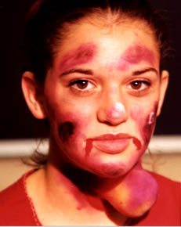
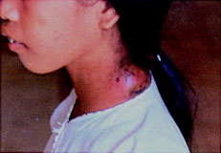
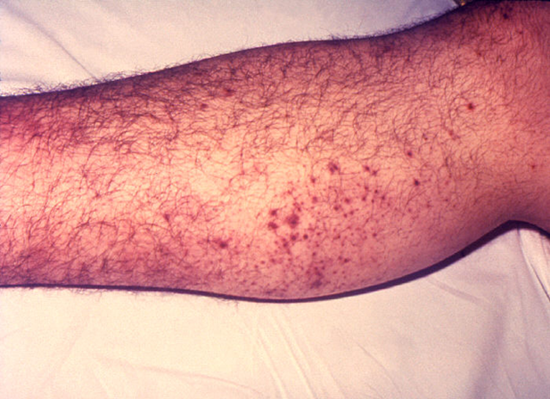

Slide 6

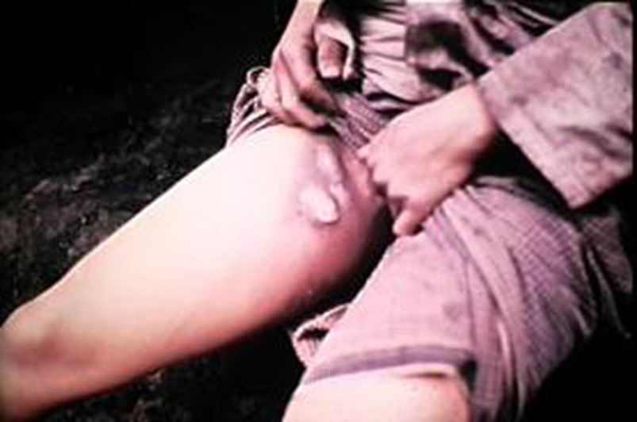
I HAVEN’T COME ACROSS THESE SYMPTONS BEFORE. MY DIAGNOSIS…

Slide 7
I PRESCRIBE………

Slide 8
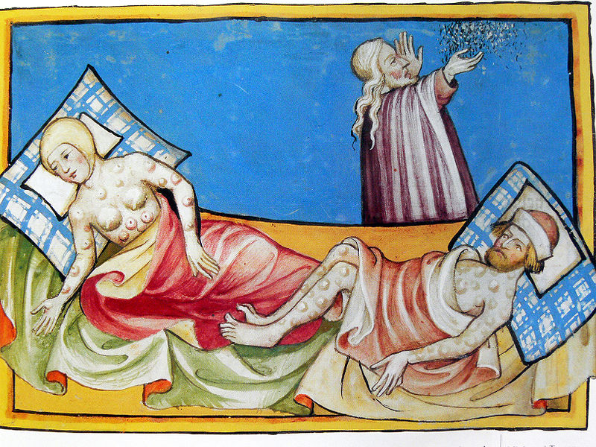

Slide 9
QUESTIONS
CAUSES OF THE DISEASE
THE BLACK DEATH
CURES
SYMPTOMS

Slide 10
Two Types of Plague
Bubonic Plague
Buboes (swellings)
Dark blotches (bleeding under the skin)
More common in summer than winter
Spasms and lots of pain.
Takes 4-7 days to die.
Spasms (fits)
Pneumonic Plague
Coughing up blood
Attacks the lungs
Not affected by climate.
Kills everyone usually within two days.
Spread by breathing in infected air.
Foul breath

Slide 11
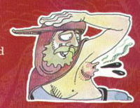
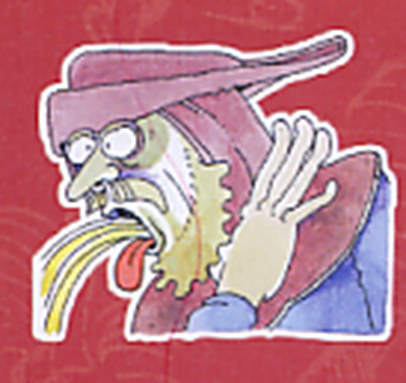
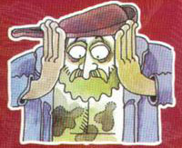
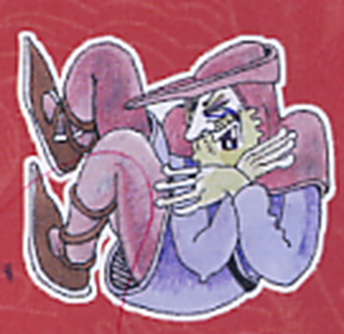

Slide 12
Paired Task
We are going to role play what it was like for a medieval doctor facing an outbreak of plague.
On the DOCTOR card, decide on and write down three questions you could ask a patient that would help you diagnose whether they had Bubonic Plague or Pneumonic Plague.
On the ILLNESS CARD write down some of the symptoms a person with that illness would have.

Slide 13
WHAT SHALL I PRESCRIBE?
LET’S TEST MY MEDICAL KNOWLEDGE AND SEE WHO HAS THE PLAGUE.

Slide 14
Second opinion time!!
If you think it is the Plague hold up the red card.
If you don’t think it is the plague hold up the blue card.

Slide 15
PLENARY
THE BLACK DEATH KILLED 7 OUT OF EVERY 10 PEOPLE.
DO YOU SURVIVE?

